Slide 1




AJAX and jQuery AJAX
AJAX Concepts, jQuery AJAX: $.ajax(), $.get(), $.post()
JavaScript for Front-End
XMLHttpRequest
SoftUni Team
Technical Trainers
Software University
http://softuni.bg

Slide 2


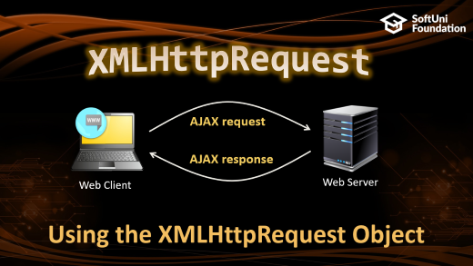

Table of Contents

Slide 3
Have a Question?
sli.do #front-end

Slide 4

What is AJAX?
AJAX == Asynchronous JavaScript And XML
Technique for background loading of dynamic content / data
Web pages / apps load data from the Web server and render it
Two types of AJAX
Partial page rendering
Load HTML fragment + show it in a <div>
JSON service
Load JSON object and display it with JavaScript / jQuery

Slide 5




AJAX: Workflow
1. HTTP request (initial page load)
2. HTTP response (HTML page)
AJAX request
UI Interaction
AJAX response (asynchronous)
AJAX handler
Returns data as JSON / HTML
Web Client
Web Server
Modify the page DOM

Slide 6
jQuery AJAX
Simplified AJAX Calls with jQuery

Slide 7
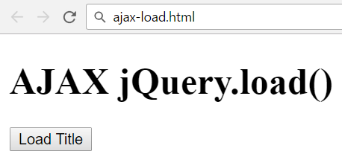
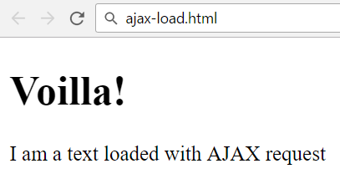
jQuery AJAX
jQuery dramatically simplifies how developer make AJAX calls
Problem: create a page holding a button
Clicking the button should load a html fragment and display it inside a div

Slide 8
Solution: jQuery.load()
ajax-load.html
<div id="text">
<h1>AJAX jQuery.load()</h1>
<button onclick="loadTitle()">Load Title</button>
</div>
ajax-load.js
text.html
function loadTitle() {
$('#text').load("text.html");
}
<h1>Voilla!</h1>
<p>I am a text loaded with AJAX request</p>

Slide 9
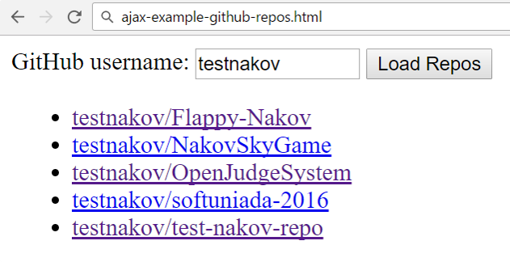
Problem: Load GitHub Repos with AJAX
GitHub username:
<input type="text" id="username" value="testnakov" />
<button onclick="loadRepos()">Load Repos</button>
<ul id="repos"></ul>
<script>
function loadRepos() {
// AJAX call …
}
</script>

Slide 10
Solution: Load GitHub Repos with AJAX
function loadRepos() {
$("#repos").empty();
let url = "https://api.github.com/users/" +
$("#username").val() + "/repos";
$.ajax({ url,
success: displayRepos,
error: displayError
});
function displayRepos(respos) { … }
function displayError(err) { … }
}

Slide 11
Solution: Load GitHub Repos with AJAX (2)
function displayRepos(respos) {
for (let repo of respos) {
let link = $('<a>').text(repo.full_name);
link.attr('href', repo.html_url);
$("#repos").append($('<li>').append(link));
}
}
function displayError(err) {
$("#repos").append($("<li>Error</li>"));
}
Check your solution here: https://judge.softuni.bg/Contests/357

Slide 12

Firebase
Mobile Back-End as a Service

Slide 13




Introduction to Firebase
A web application always has a Front-End part and a Back-End part.
Each side may be simulated depending on the application.
MBaaS helps simulate the Back-End part of an application.
Offers a back-end platform which you can consume.
Offers a data storage service.
Offers implemented functionality and security.

Slide 14

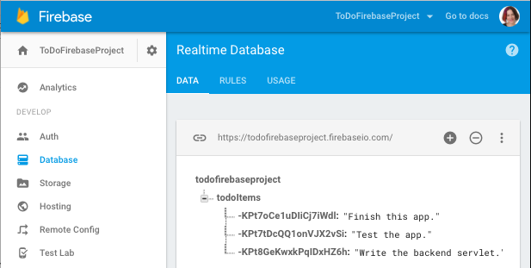
Introduction to Firebase
Firebase is a mobile and web application development platform.
Offers many services that make application development smooth and easy:
Analytics
Cloud Messaging
Authorization
Database & Storage
Hosting

Slide 15

Firebase
Demo. Firebase Playground

Slide 16
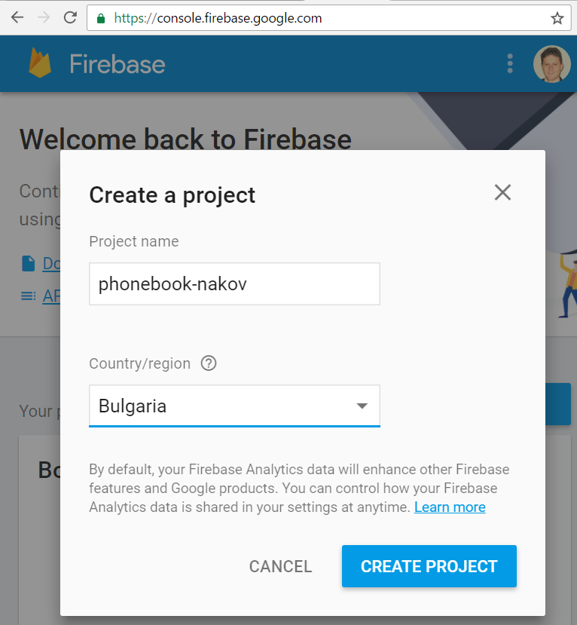
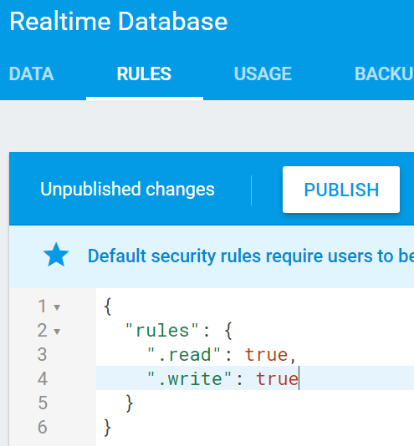
Solution: Setup a Firebase DB
Open https://console.firebase.google.com/
Create a new project
Enable public read / write access

Slide 17
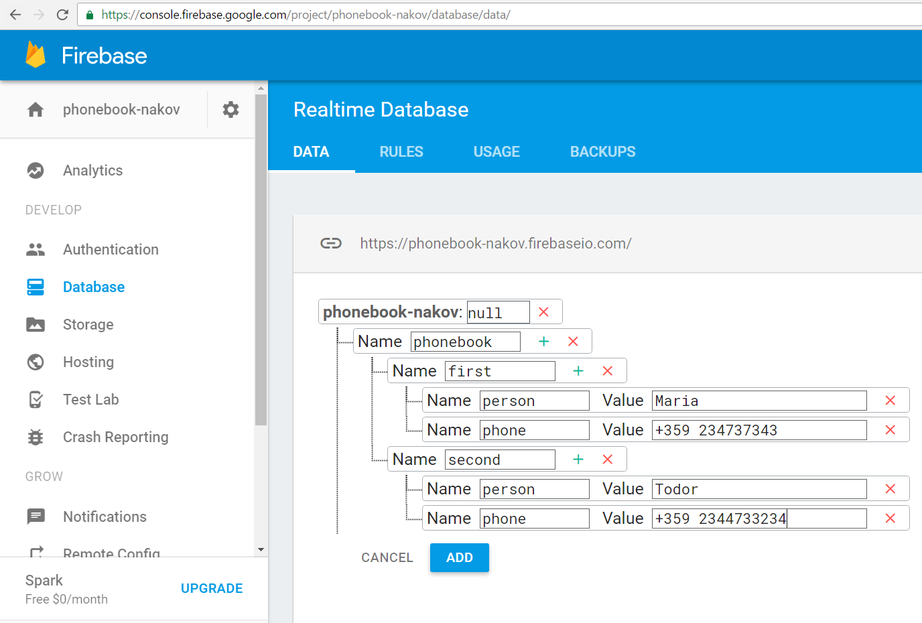
Solution: Add Sample Data in Firebase

Slide 18
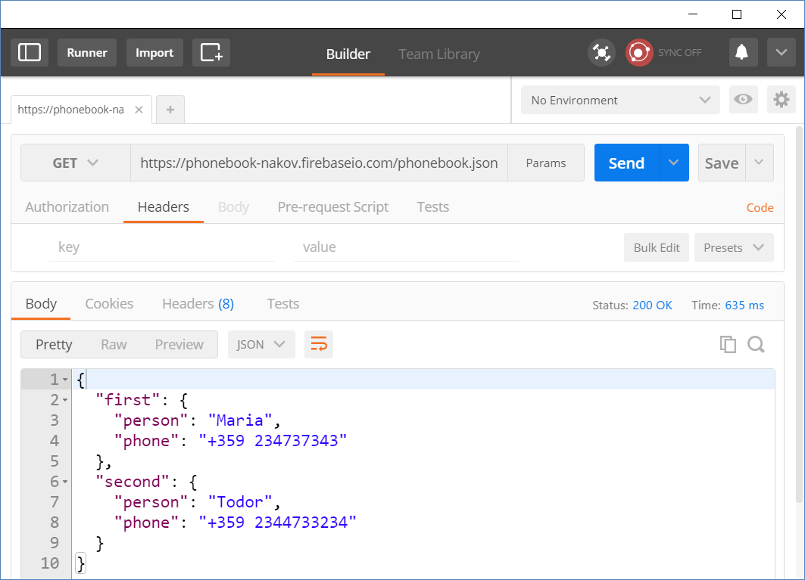
Solution: Test Your REST Service

Slide 19



Summary
AJAX sends asynchronous HTTP requests from JS
jQuery simplifies how developers use AJAX
$.ajax({ url, method: 'GET',
success: displayRepos,
error: displayError
});
function displayRepos(respos) { … }
function displayError(err) { … }
}

Slide 20







JS for Front-End – Introduction to AJAX
https://softuni.bg/courses/javascript-for-front-end

Slide 21






SoftUni Diamond Partners

Slide 22






SoftUni Diamond Partners

Slide 23
License
This course (slides, examples, demos, videos, homework, etc.) is licensed under the "Creative Commons Attribution-NonCommercial-ShareAlike 4.0 International" license

Slide 24





Trainings @ Software University (SoftUni)
Software University – High-Quality Education, Profession and Job for Software Developers
softuni.bg
Software University Foundation
http://softuni.foundation/
Software University @ Facebook
facebook.com/SoftwareUniversity
Software University Forums
forum.softuni.bg

